Slide 1

Data Science Committee
Session 07 – Machine Learning Overview
Prepared by: Ashraf Abdulkhaliq

Slide 2
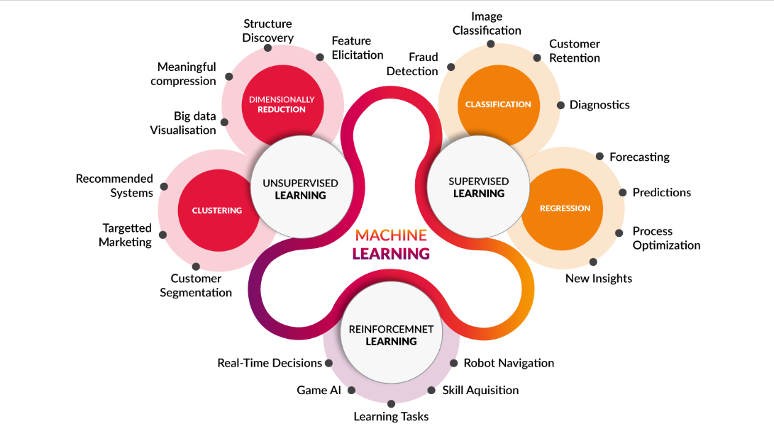
Introduction

Slide 3
Outline
What is Machine Learning
ML Algorithms Overview
Confusion Matrix
Evaluation Metrics

Slide 4
Outline
What is Machine Learning
ML Algorithms Overview
Confusion Matrix
Evaluation Metrics

Slide 5
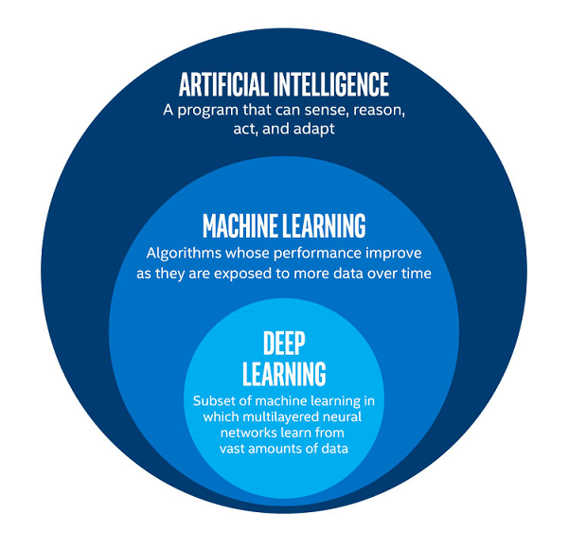
What is Machine Learning
Machine learning is a branch of artificial intelligence, a science that researches machines to acquire new knowledge and new skills and to identify existing knowledge.

Slide 6
Outline
What is Machine Learning
ML Algorithms Overview
Confusion Matrix
Evaluation Metrics

Slide 7
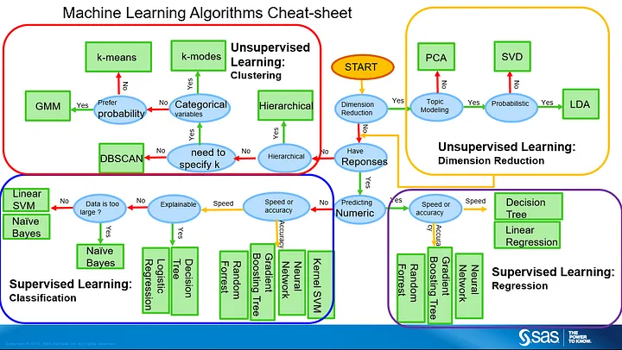
ML Algorithms Overview

Slide 8
Aspect | Distance-Based Algorithms | Probability-Based Algorithms | Tree-Based Algorithms
Nature of Output | Regression and Classification | Regression and Classification | Regression and Classification
Decision Making | Decides based on how close things are in points | Decides based on likelihoods or chances/probability | Decides by following a tree-like structure
Example Algorithms | k-Nearest Neighbors (KNN) | Naive Bayes | Decision Trees, Random Forest, XGBoost
Training Time | Can be quick for small amounts of data | Can be quick for small amounts of data | Depends on the complexity of the tree and data size
Scalability | Can be slow for lots of data | Usually handles lots of data well | Generally good, especially when using many trees
Handling Outliers | Can be influenced by unusual data points | Not easily swayed by unusual data points | Can be affected by outliers in the data
Interpretability | Can be a bit tricky to understand | Usually makes sense to people | Kind of makes sense, but not always straightforward
Parameter Sensitivity | Can be picky about settings like how many neighbors to consider | Can be sensitive to assumptions about data | Sensitive to settings like tree depth and complexity
Handling Missing Values | Sometimes needs extra care with missing information | Generally okay with missing data | Can handle missing info to some extent

Slide 9
Outline
What is Machine Learning
ML Algorithms Overview
Confusion Matrix
Evaluation Metrics

Slide 10
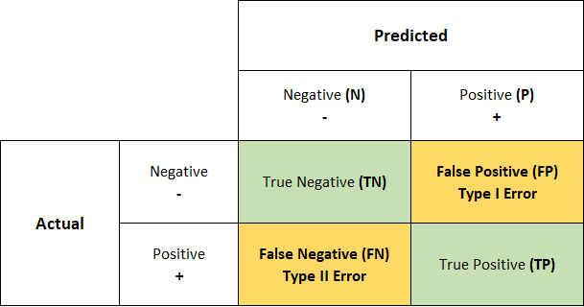
Confusion Matrix

Slide 11
Outline
What is Machine Learning
ML Algorithms Overview
Confusion Matrix
Evaluation Metrics

Slide 12
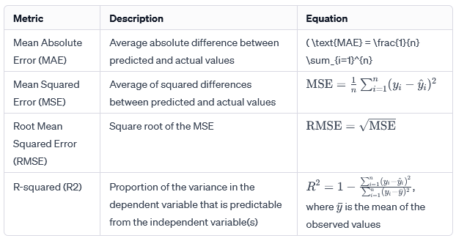

Evaluation Metrics for Regression

Slide 13
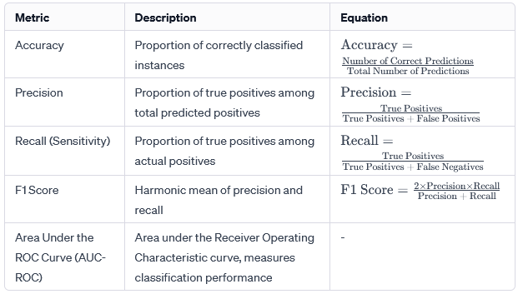
Evaluation Metrics for Classification

Slide 14
References
https://medium.com/ml-research-lab/machine-learning-algorithm-overview-5816a2e6303
https://www.anandtech.com/show/12673/titan-v-deep-learning-deep-dive/2

Slide 15
Thanks
Please keep updated:
https://github.com/kershrita/Data-Science-Roadmap

